Slide 1
TELCO CUSTOMER CHURN
J o n a t h a n B e c k

Slide 2




01
02
Project Goals
03
Data Description
Problem Statement
04
05
Preprocessing
06
Data Visualization
OVERVIEW
Initial Data Issues
07
Training & Validation Split
08
Baseline Model
09
Decision Tree Insights
10
Optimal Model
11
Decile Chart Insights
12
Final Analysis, Recommendation, & Strategy

Slide 3







PROBLEM STATEMENT
01
TELCO
PROBLEM
Have noticed that roughly 26% of the 5000+ customers in database have defected to the competition.
Telecommunications Company.
Offer a variety of services to their customers such as Internet Service, Phone lines, and television streaming.
Customer ending contract = lost revenue

Slide 4



PROJECT GOALS
02
01
Board of Directors at Telco are unsure what is most contributing to a customer deciding to leave Telco. They would like this issue to be identified so that the issue can be rectified accordingly.
02
Using the data on hand, they would like me to design a model that is able to predict propensity rates of customer churn.
03
As they want a better understanding of the factors contributing to customer churn, they would also like me to propose solutions to the marketing and sales department, so that the customer churn rate can be decreased going forward.
Ideally, they would like to see the customer churn
04
rate brought down by 5-10%.

Slide 5


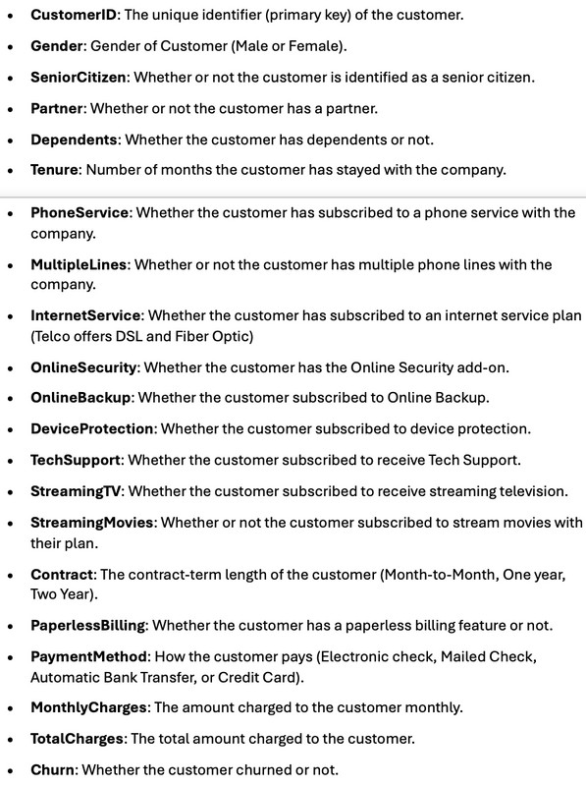
03

Slide 6

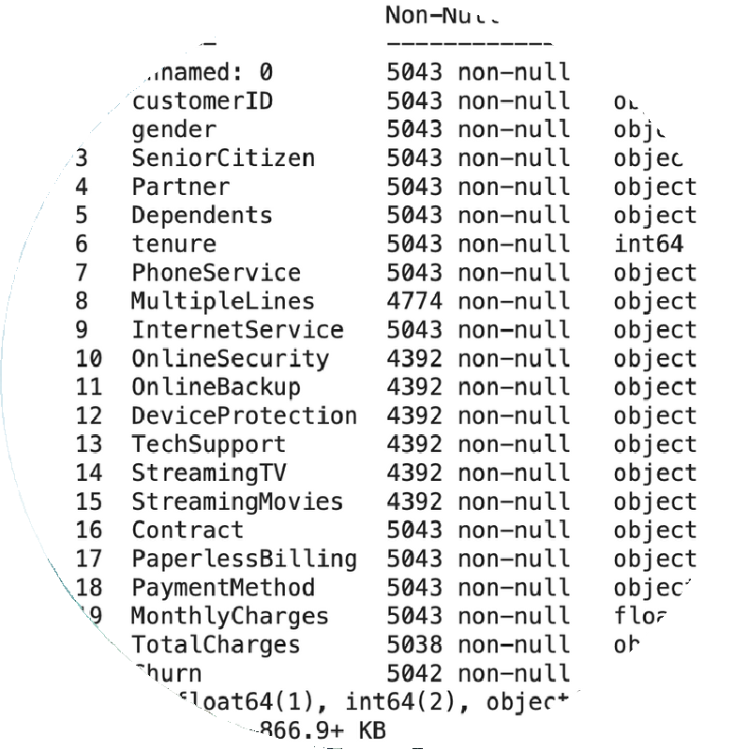
04
Numerous Features with a large amount of missing values.
Numerous features that would expect to be of "Integer" data type stored as object e.g., Senior Citizen having character values rather than binary digits.
Total Charges stored as an object rather than as floating point decimals.

Slide 7





BOOLEAN VALUES
Replaced all "Binary Strings", such as "0", "No", "1", "True"” found across the binary categorical columns with appropriate boolean values.
TOTAL CHARGES
Converted the 'Total Charges' column into a FLOAT data type.
In doing this, I found that a small handful of the records contained empty strings in this column rather than a missing value or a 0. Handled this with K-Nearest Neighbors imputation.
05
HANDLING MISSING VALUES
Found that, typically, a feature contained a null value if its "parent" feature contained a False value. E.g., if a customer didn't have "Phone Service" than a feature such as "Multiple Lines" either contained No Phone Service or a null value. For these instances, I replaced the Null with a "No Service" string value.
One record dropped. Missing response value.
DUMMY VARIABLES AND BINARY 0/1 TO REPRESENT "CHURN" VS "NO CHURN"

Slide 8





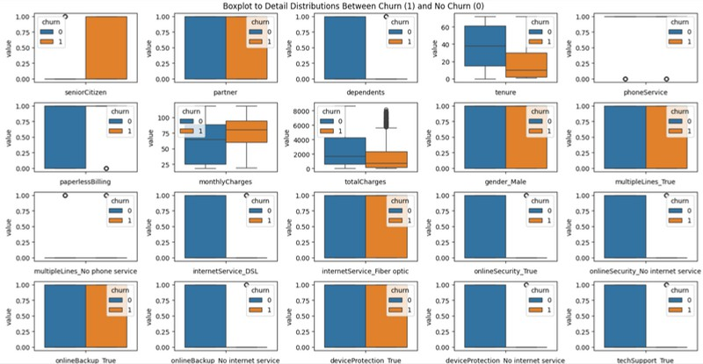

06

Slide 9




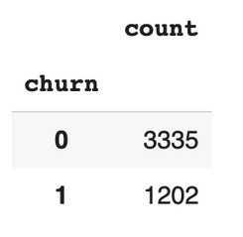
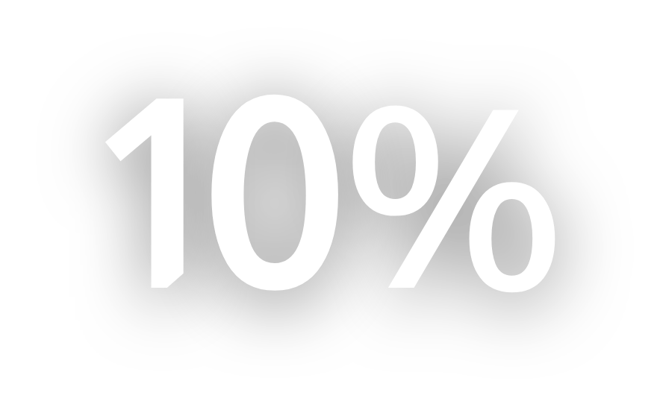
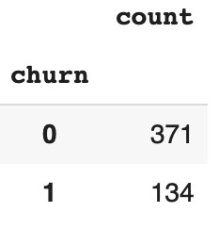
07
Used for training. Dropped the "Partner" feature. 4537 customer records.
Set the stratify parameter to "y" in splitting to ensure equivalent proportion of "churn" and "no churn" customers was maintained in both training and validation sets because imbalanced class distribution.
Used for validation. 505 customer records

Slide 10
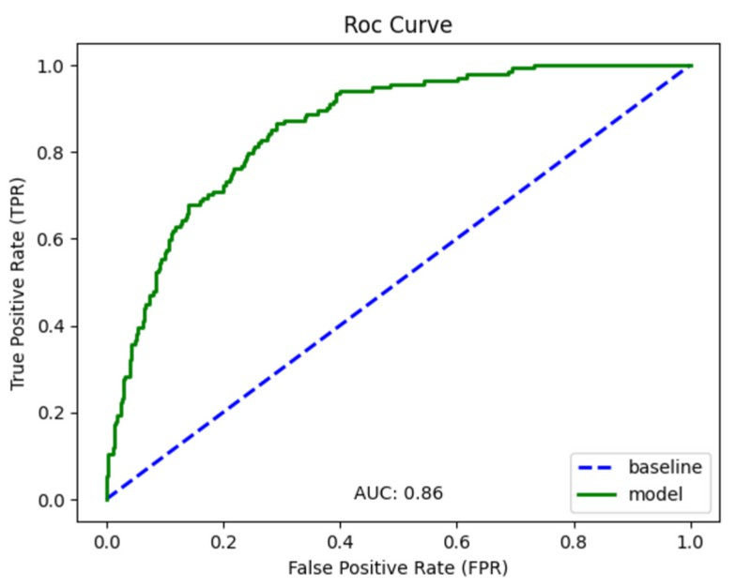
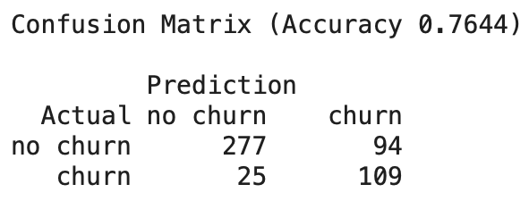
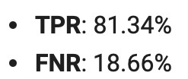
BASELINE MODEL
08
LOGISTIC REGRESSION
Max Iterations -> 1000
Maximum number of iterations solver runs before choosing beta coefficients that minimize loss function.
Class Weights -> Balanced
Wrong predictions on the minority class/class of interest (Churn) carry more weight.
Therefore, model doesn't become biased towards over populated class (No Churn)

Slide 11
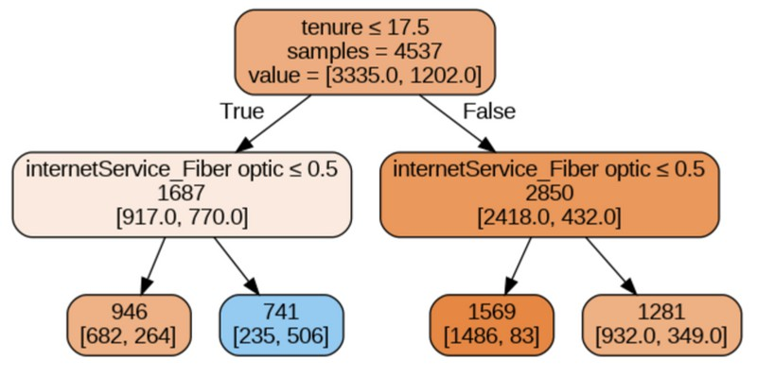
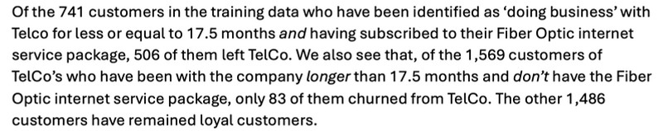
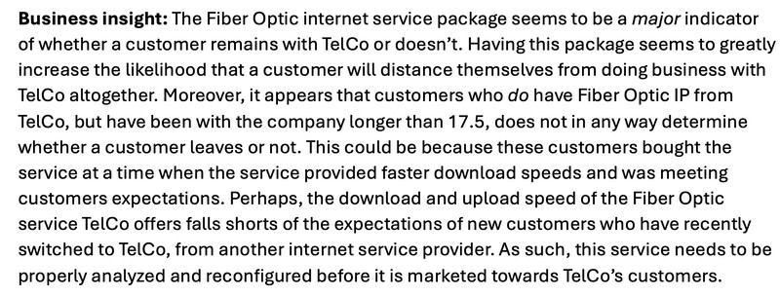
DECISION TREE INSIGHTS
09
Used a Decision Tree visualize most important features and their interactions.
Although the Decision Tree algorithm didn't perform as well as my eventual best Logistic Regression Model, provided my first major insight.

Slide 12
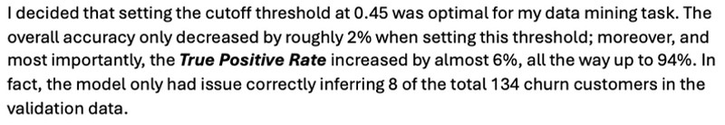
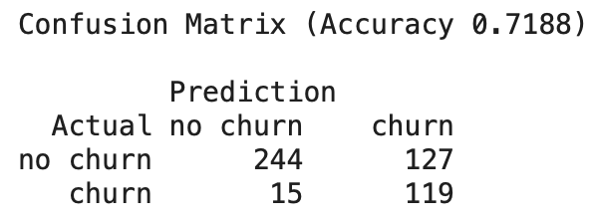
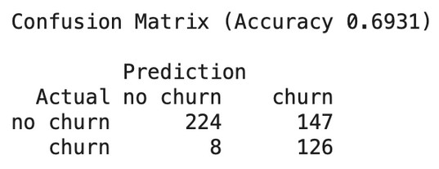

OPTIMAL MODEL
10
LOGISTIC REGRESSION @ 0.45 Threshold
Standard Scaling
Helped model converge on best solution and greatly improved efficiency of hyperparameter tuning using Grid Search Cross Validation
Grid Search CV Settings
K-Fold Cross Validation -> 5 Scoring -> Recall
Maxize True Positive Rate. Naturally lowers False Negative Rate at expense of decreased Accuracy Rate
Selected Hyperparameters Class Weight -> Balanced Penalty - > L2
Discourages large coefficients but does not drive any to 0.
C -> 5
Permits slightly larger coefficients.
Intercept -> False Solver -> lbfgs
Loss Minimization function. Supports L2 regularization specifically.

Slide 13

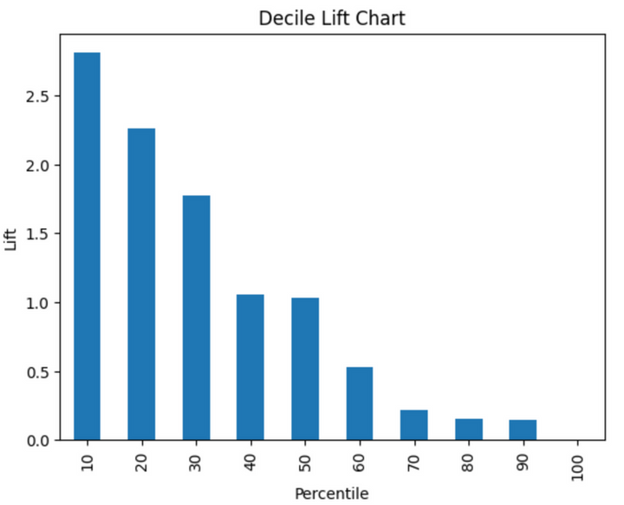
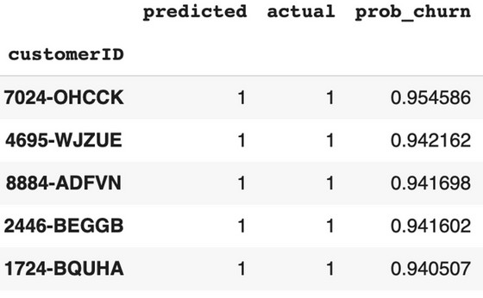

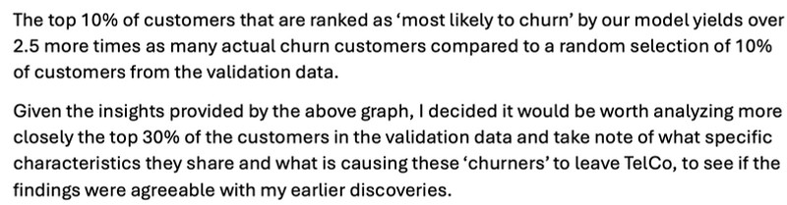
DECILE CHART INSIGHTS
11

Slide 14
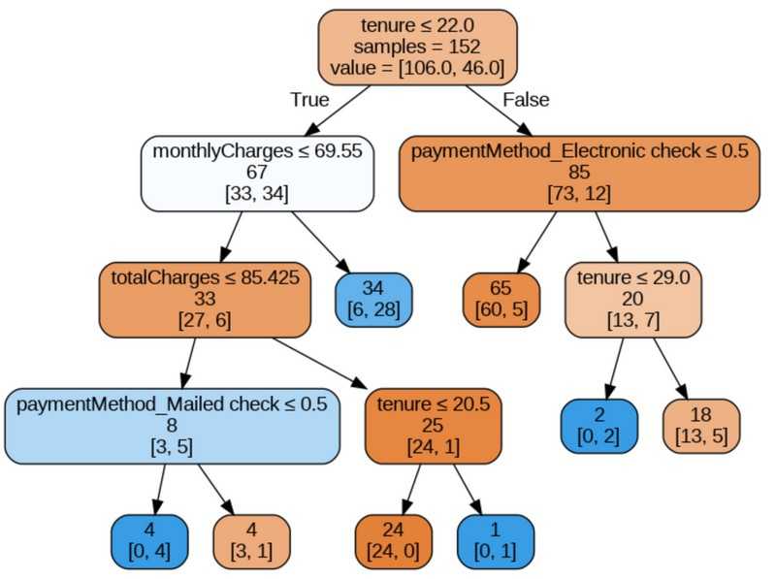

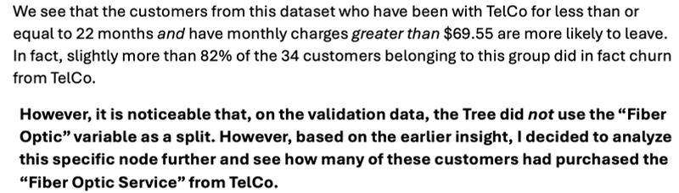
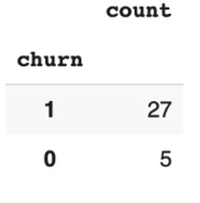
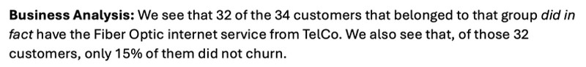
12
STRATEGY FOR ANALYSIS
RESULTING TREE
Decided to fit a Decision Tree to the top 30% of my validation data on hand.
Methodology
Merged the original validation dataframe (consisting of 505 customers) to the ad-hoc 'predicted classes'’dataframe I had created to construct the Decile Chart. Simple becaused customerID was kept as primary key in both.
Sorted records in descending order, based on "probability of churn".
Used the iloc method to only run the first 152 records through the tree.

Slide 15

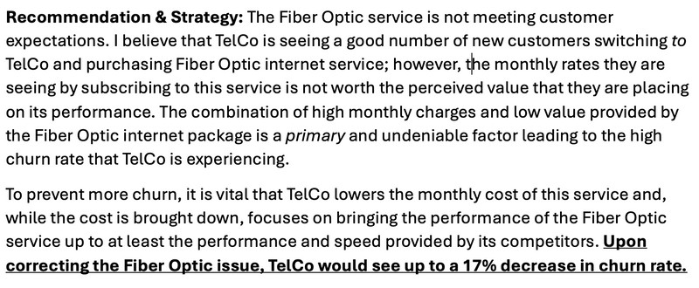
12

Slide 16

APPENDIX
01
Additional Techniques Attempted
02
Performance on Test Data

Slide 17




01
RANDOM FOREST
DECISION TREES
GRADIENT BOOSTING
K-NEAREST NEIGHBORS
VOTING CLASSIFIER
INTERACTION TERMS & POLYNOMIAL FEATURES
OVERSAMPLING
FEATURE SELECTION

Slide 18

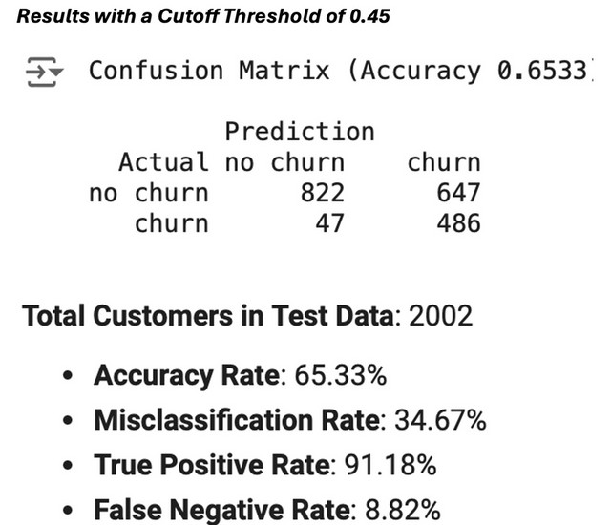
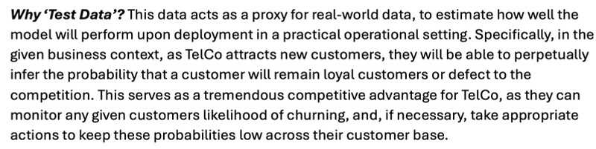
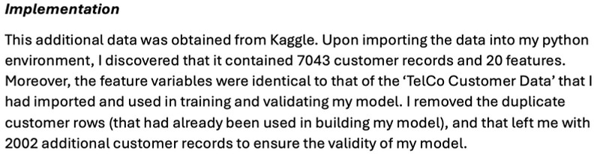
PERFORMANCE ON TEST DATA
02

Slide 19





